Slide 1
Billing Management System

Slide 2
Topics covered
Objective
Screenshots
Functioning
Conclusion

Slide 3
objective
The project will solve the following objectives: -
Add and maintains records of available products.
Add and maintains customer details.
Provides convenient solution of billing pattern.
Make an easy to use environment for users.
Practice PYTHON as window application language.

Slide 4
Screenshots and functioning

Slide 5
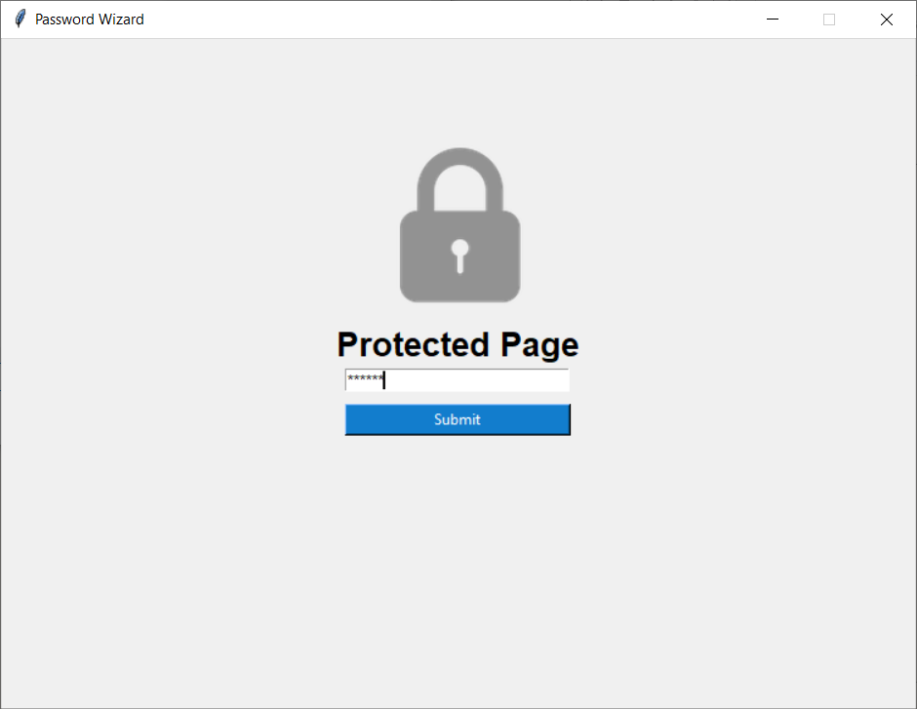
Opening of the project
Hash algorithm is used.
One time setting of password.
Security
SHA - 512

Slide 6
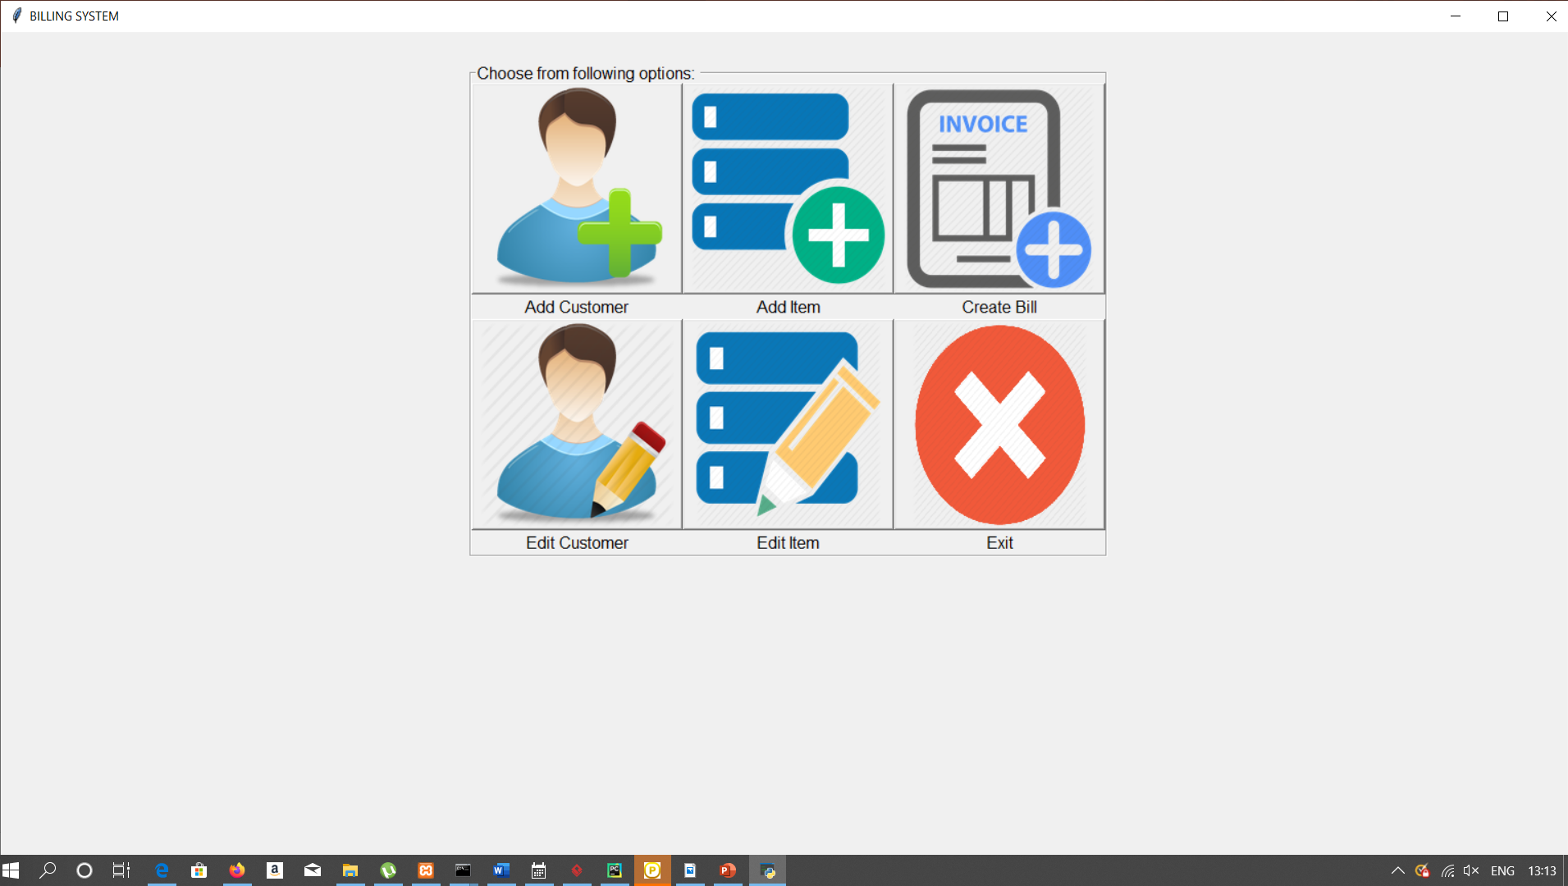
Main window panel
6 functioning are given:
Add customer
Add item
Edit item
Edit customer
Create bill
Exit

Slide 7
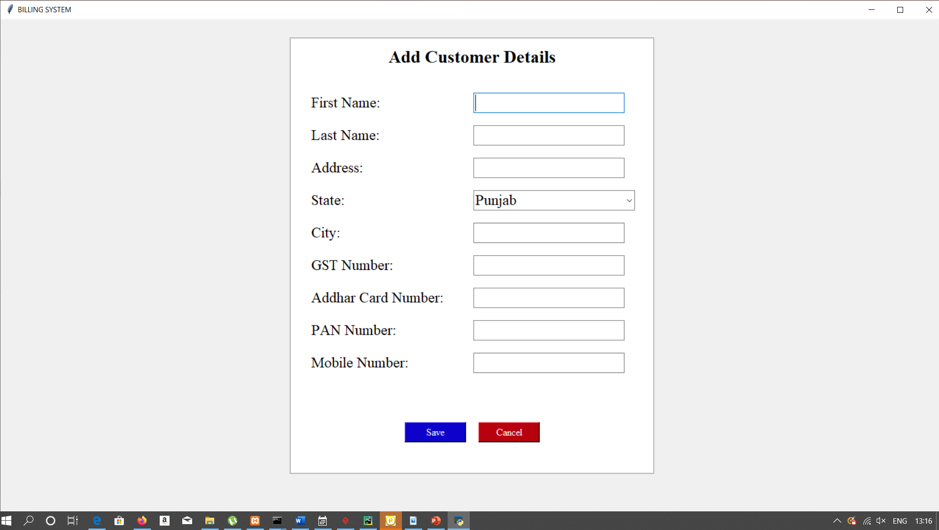
Add customer
We can add new customer using this window. All types of validations are applied. After that data is saved in the database.

Slide 8
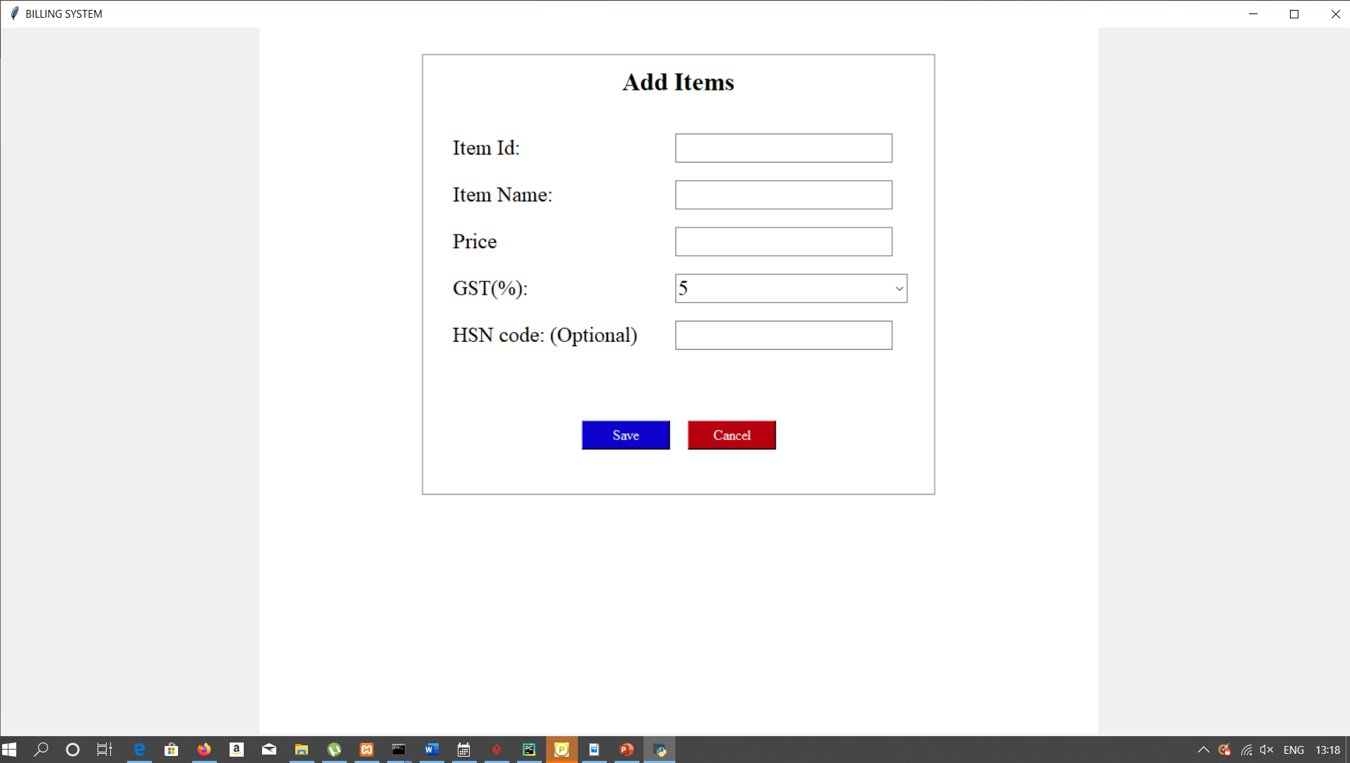
Add item
We can products of company in this panel.
All the text box values are verified first before entering database.

Slide 9
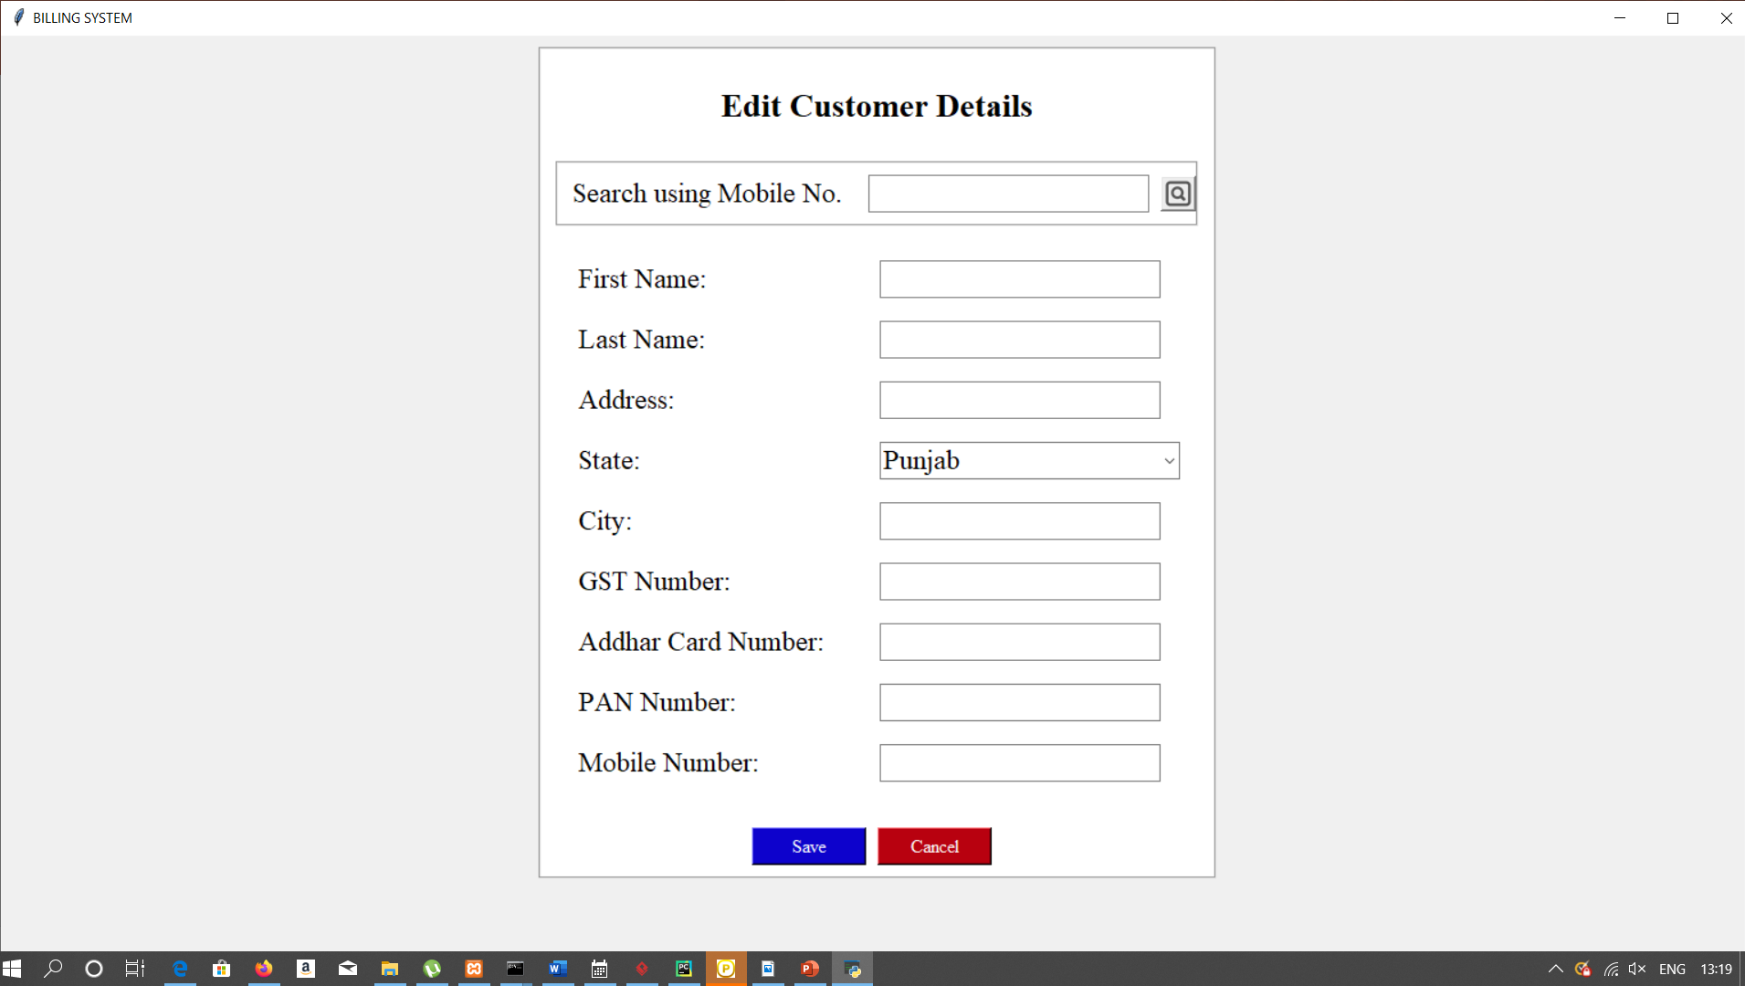
Edit customer
Search using mobile number.
Mobile number is a primary key used.
Data already stored in database gets retrieved and updated again.

Slide 10
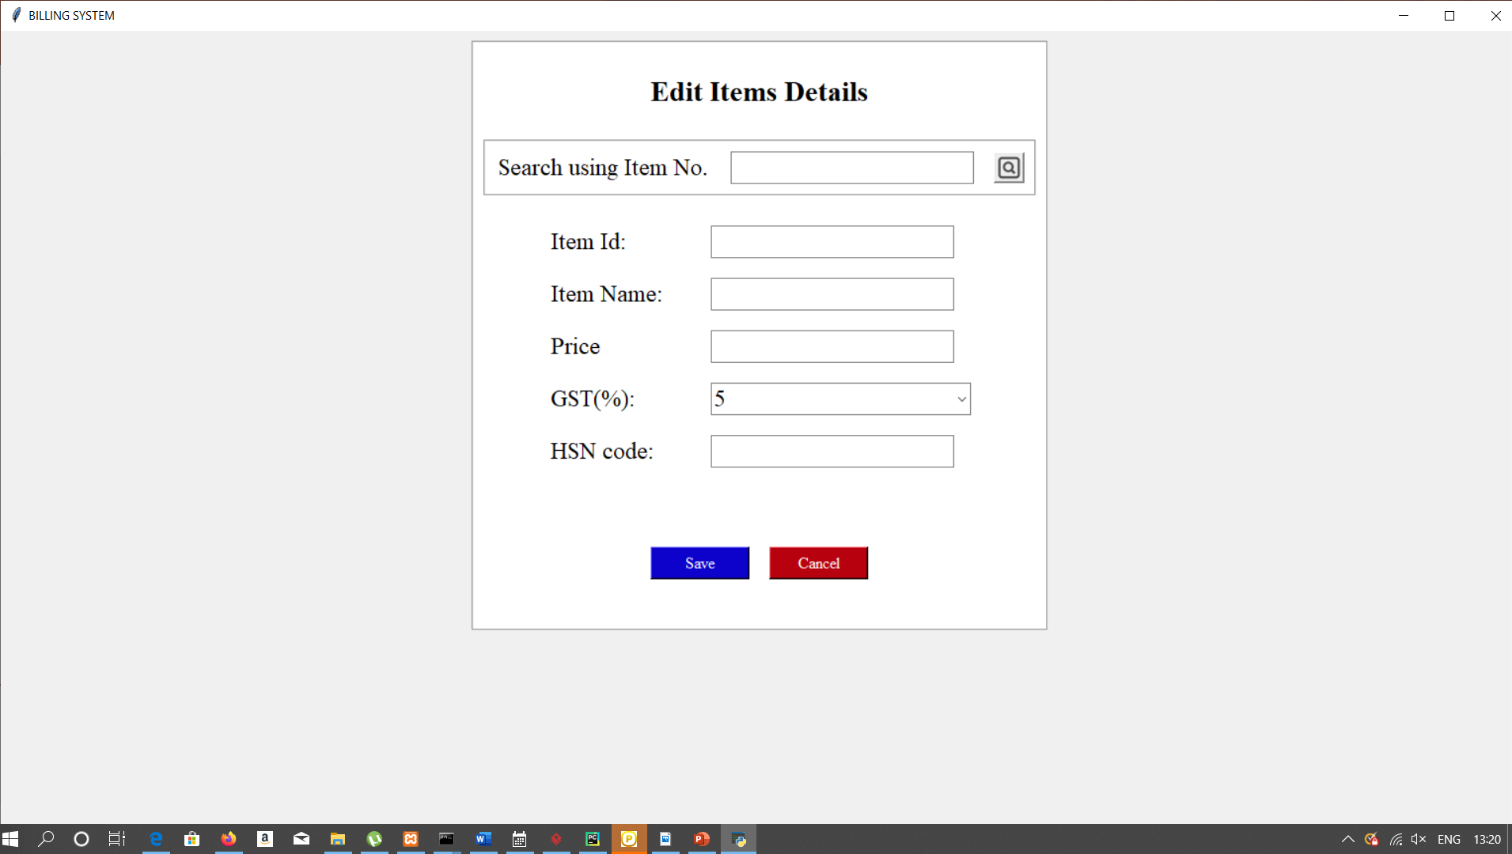
Edit item
Item number is used as primary key to retrieve data from database.
Updating of data can be done.

Slide 11
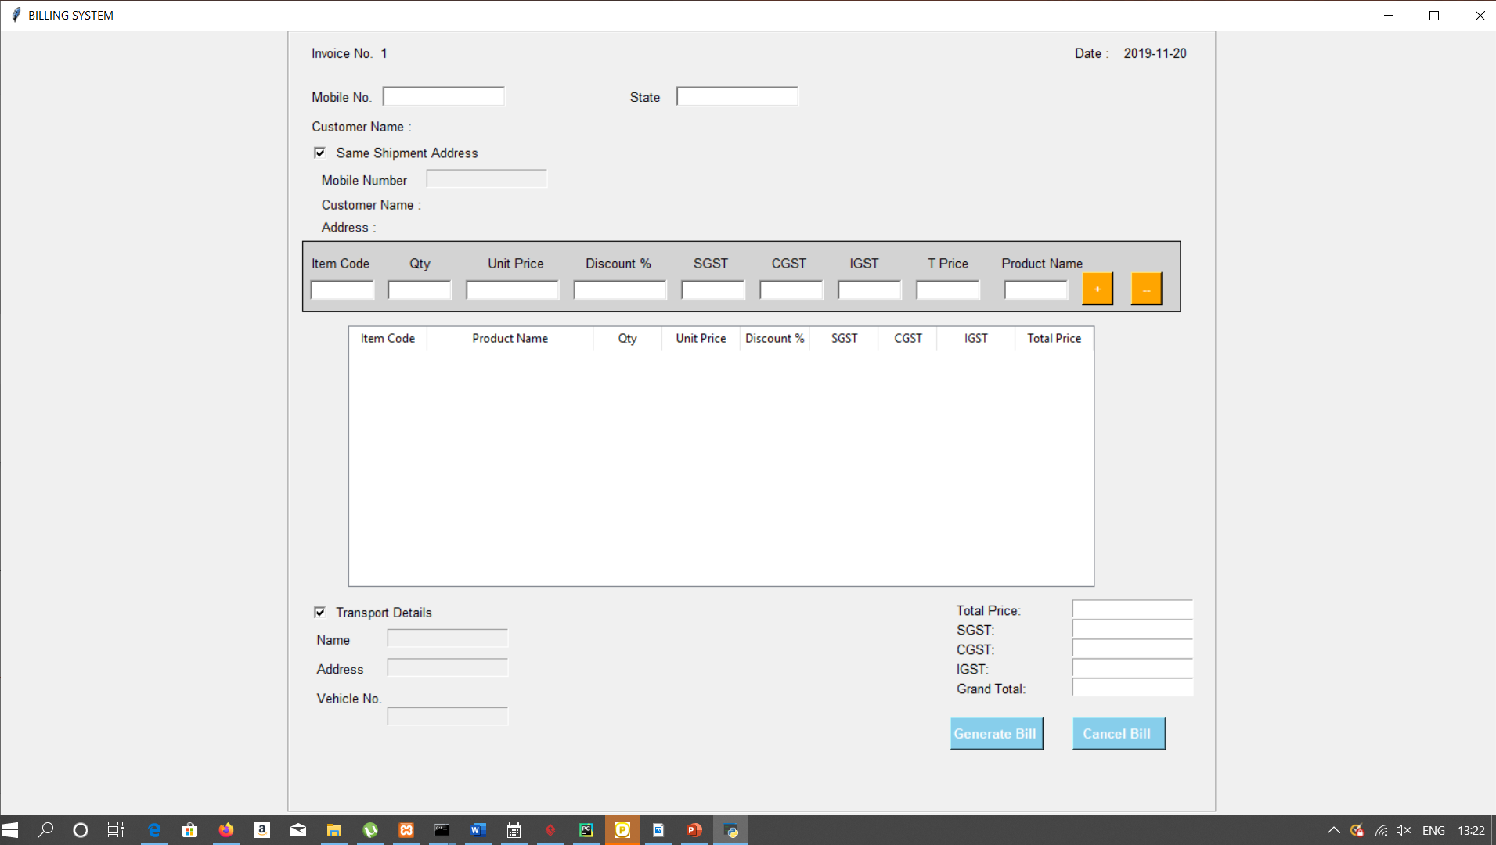
Create bill
Bill is created dynamically.
Item numbers and customers can be added those are already stored.
Provides security

Slide 12
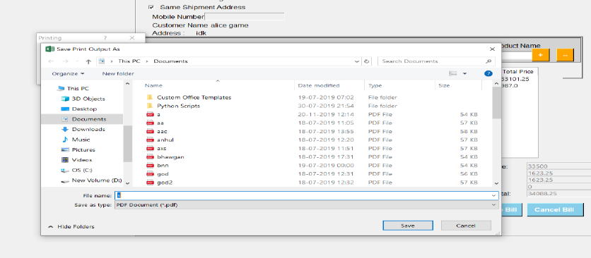
Saving bills
Bills created and saved to as pdf format.

Slide 13
conclusion
The system has been developed with much care and is free of errors and at the same time is efficient and not time consuming. The purpose of the project was to develop a window based application from which a user can create bills.

Slide 14
Future scope
Machine learning implementation.
More visual data representation can be done using matplotlib and seaborn libraries.

